Slide 1
CYCLISTIC ANALYSIS CASE-STUDY

Slide 2
Presentation By: Fahad Iftikhar
LinkedIn: LinkedIn Profile
Complete Project:
Tableau Visuals: tableau.data viz
Note: This analysis was performed using R and visuals were created in Tableau.

Slide 3
Analysis Purpose:
Support the decision making process behind supporting or opposing a marketing strategy that attempts to convert casuals into members.
How do members and casual riders use cyclistic differently?
The Challenge:

Slide 4
Hypothesis:
Casuals use cyclistic bikes for leisure.
Members use cyclistic bikes for commuting.
Most of the casuals are outside visitors while members are citizens of that area

Slide 5
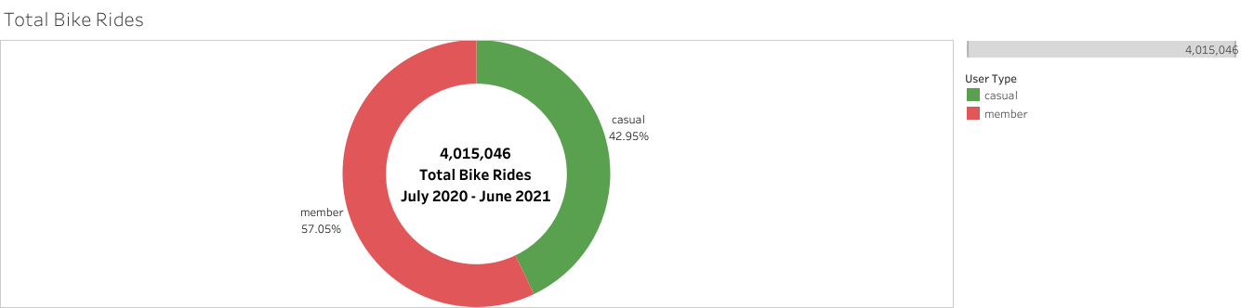
Total Bike Rides
Notes:
Out of the total 4015046 bike rides 1724662 (42.95%) were casual riders and 2290384(57%) were members. This shows that members take more rides than casuals as they should because they pay for annual pass.

Slide 6
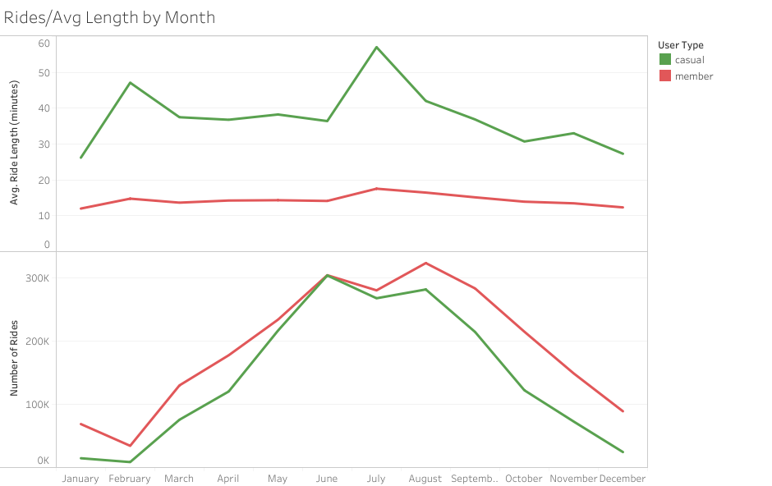
Average Ride Length
Notes:
This graph shows that casuals take more time travelling from one station to an-other while members take less time.

Slide 7
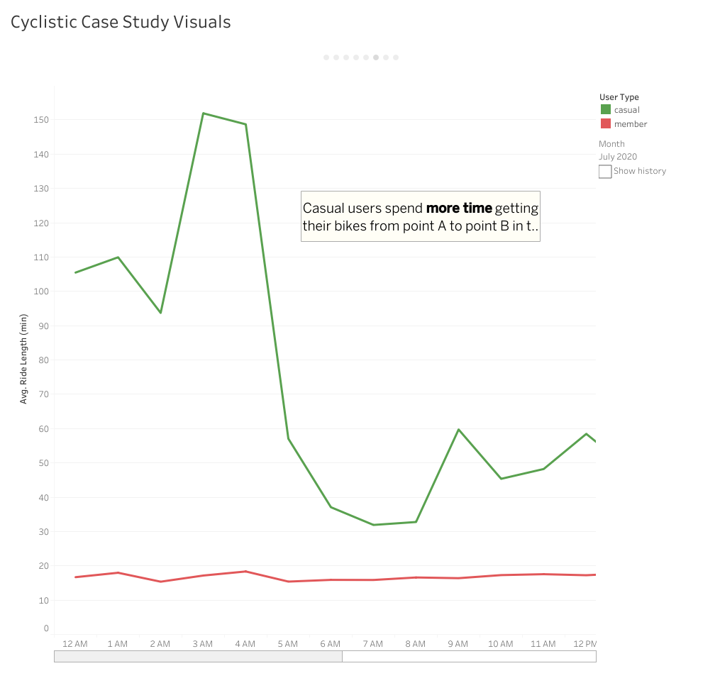
Ride time: members vs casuals
Notes:
One of the reason for longer ride time in casuals is that they use their bikes for leisure and they might stop between two stations for refreshments or something else.

Slide 8
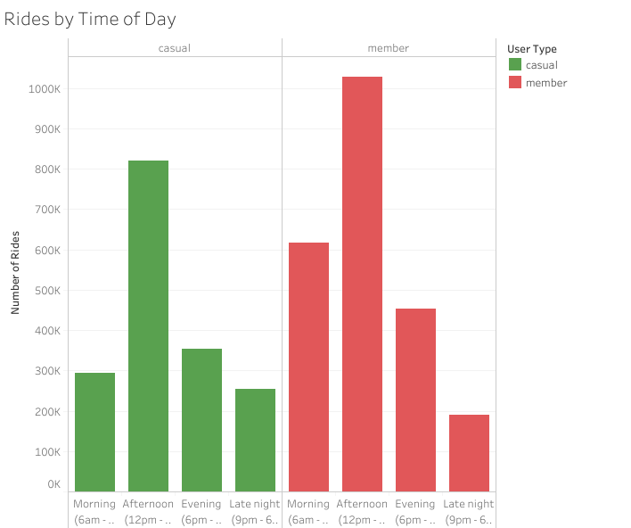
Rides by Time of the Day:
Notes:
Casuals have more numbers of rides in morning afternoon and evening but members have more rides late night. This might be because members use their bikes for commute and some people have late night jobs while casuals usually ride during daylight as they ride for leisure.

Slide 9
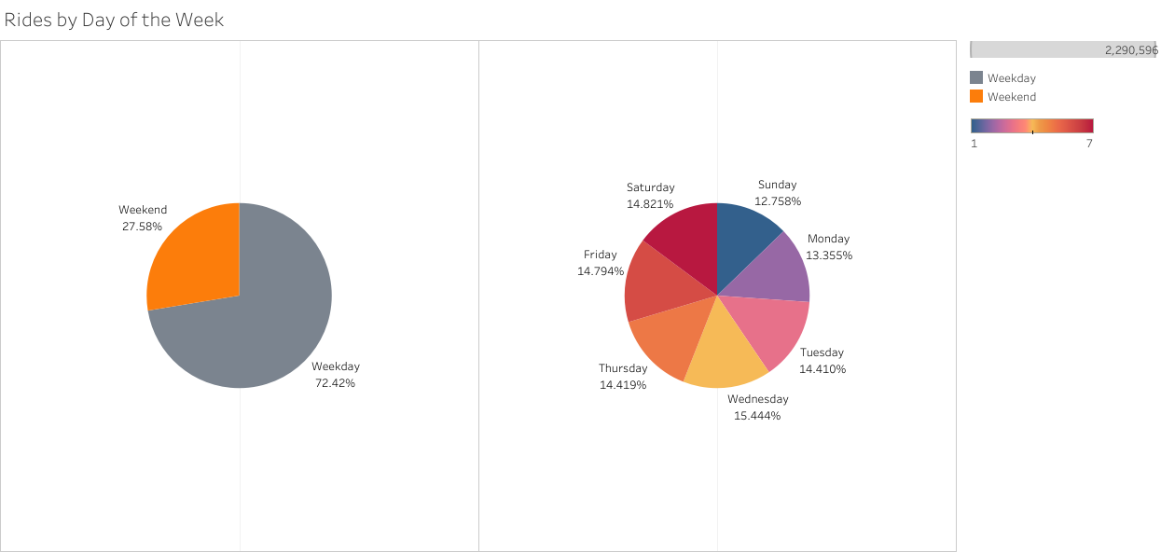
Rides by Day of the Week
Notes:
When we take a look at rides by the day of week we see that there is no big difference for members. They have somewhat same number of rides around the week. The number of rides decreases on Sunday.

Slide 10
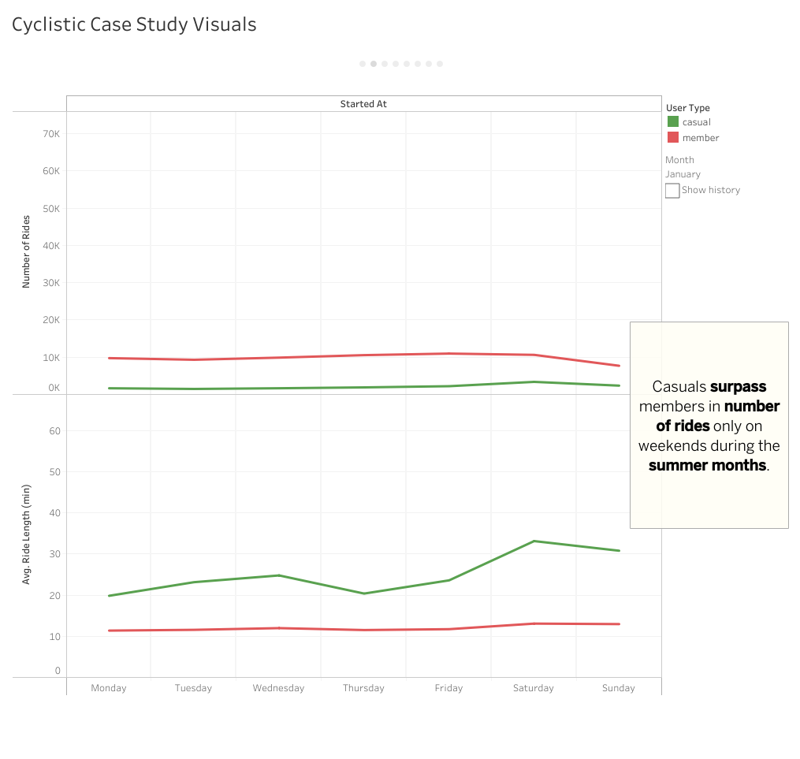
No of Bike rides in Summer

Slide 11
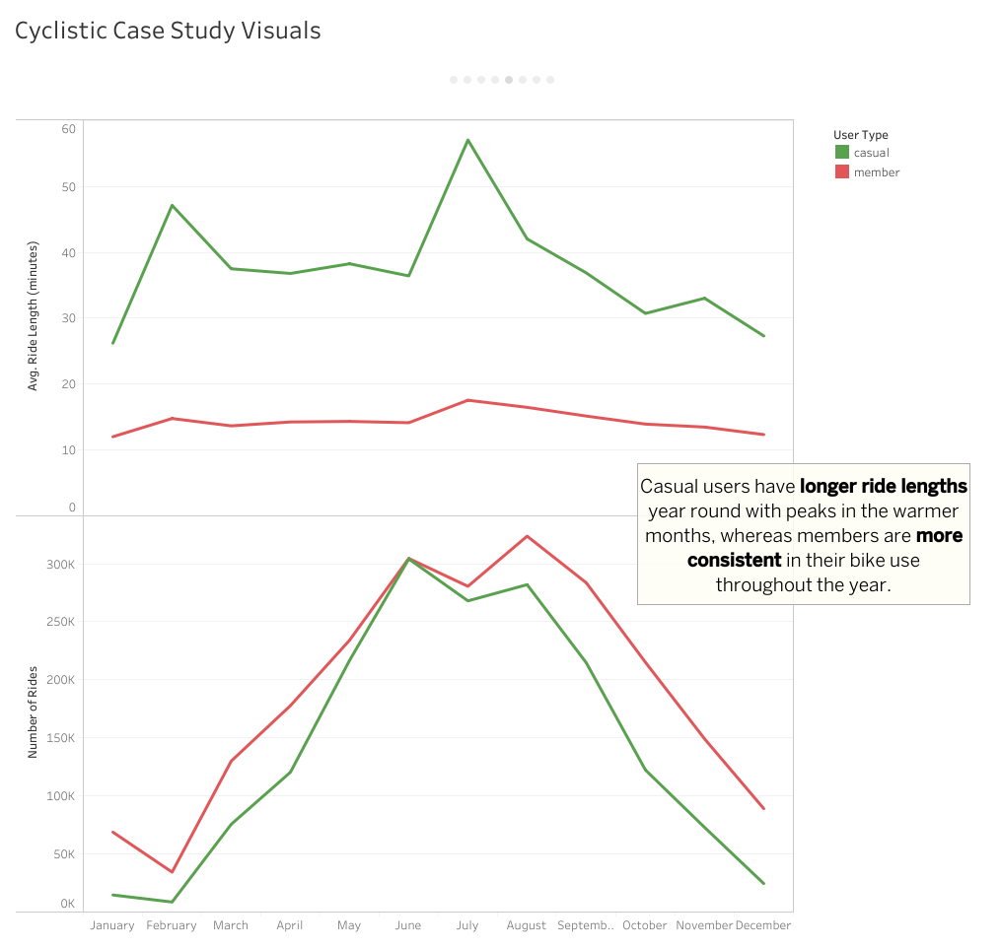
Ride Length around the Year
Notes:
Casuals have longer ride lengths around the year with peaks in warmer months maybe because some people visit the city in summer to go around the beach whereas members are more consistent in their bike use throughout the year.

Slide 12
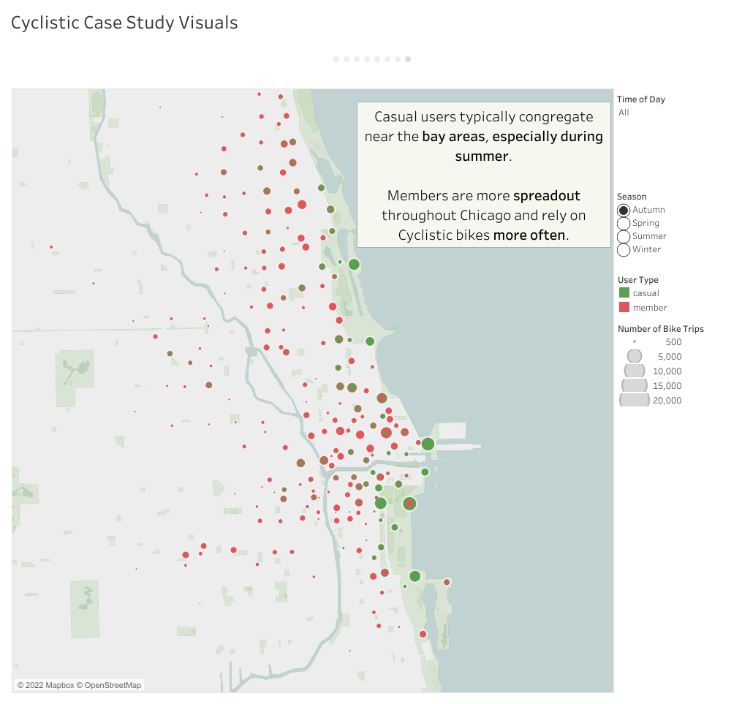

Area of Trips(Autumn & Spring):
Notes:
During the month of autumn and spring the number of rides and the area of rides are almost the same. Members are more spread-out around the city while most of the casuals ride around the bay area.

Slide 13
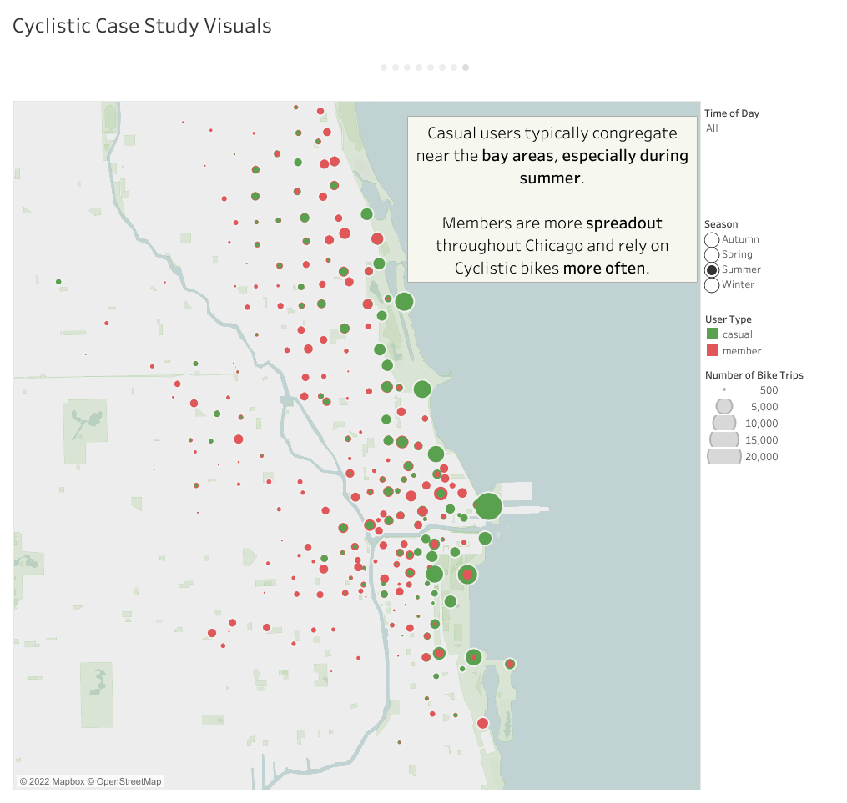
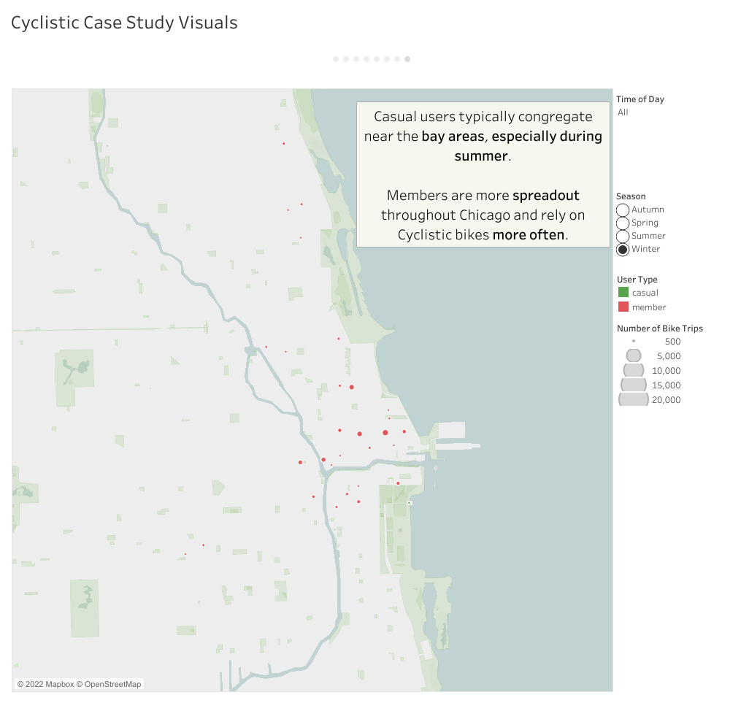
Area of Trips(Summer & Winter):
Notes:
As we can see from the visuals there are more casuals in summer season while there are little to no casual riders in winter season. This might be because outsiders visit this city in summer.

Slide 14
Ride Length by Month
Notes:
Ride lengths are highest in the season of summer and are lowest in the season of winter. This might be because of cold winters when people do not like to ride because of cold or because there are no visitors in the winter season.

Slide 15
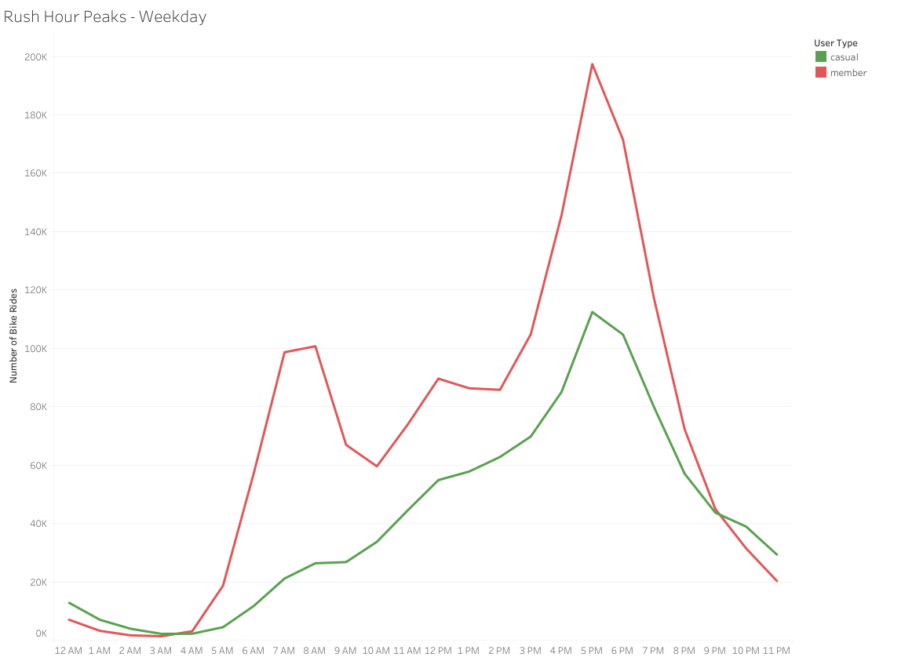
Rush Hour Peaks - Weekdays
Notes:
Members are more active in the time between 6 am to 6 pm. This might be because of the work timings of that particular area.

Slide 16
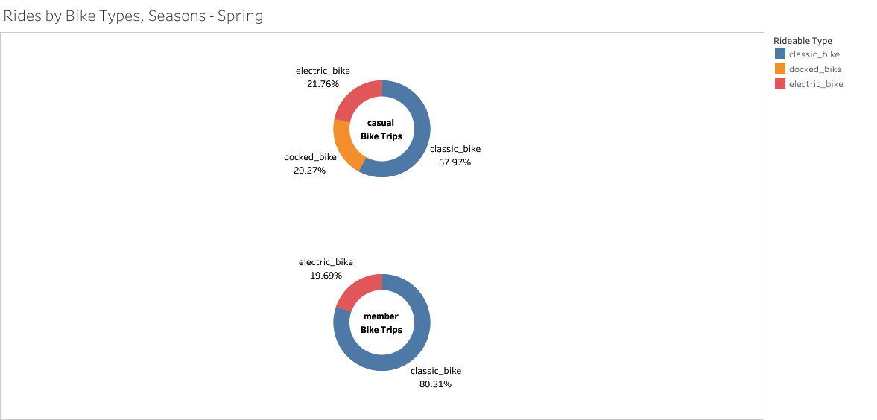
Bike Types
Notes:
Looking at this visualization we can analyze that members prefer classic bikes over electric bike. This is also similar in case of casuals but there are some casuals who just take whatever bike is available on the docking station.

Slide 17
Conclusions:
Looking at the data we can analyze that cyclistic bikes are used most in summer and least in winter.
We also found out that members are more active on week days while casuals are more active on week-ends.

Slide 18
Strategies:
We can introduce a weekend pass which will allow casuals who ride on weekends to convert into members.
We can introduce a summer pass which will allow casuals to ride around the city with a low price than they would have to pay around the summer season.
We can introduce a bike reservation app to our members that will allow them to reserve a bike at any time of the day which will temp casuals to convert to members as casuals use different bike types all the time

Slide 19
THANK YOU

